Slide 1


DIGITAL PLATFORMS
FOR THE AI ERA
For McKinsey & Company
Siddesh Pednekar
Partner & COO
CONFIDENTIAL AND PROPRIETARY | © BombayDC.
This material is intended solely for your internal use and any use of this material without specific permission of BombayDC is strictly prohibited. All rights reserved.
sid@bombaydc.com
9819981354

Slide 2



1
WHO WE ARE
A strategic digital platform firm helping enterprises build intelligent digital platforms that increase adoption, retention, and revenue.
EXPERIENCE
SCALE
TRUST
CLIENTS
10
80
85%
Kotak Mahindra Bank
Bharat Connect - NPCI
AU Small Finance Bank
Aditya Birla Capital
Tata Communications
VIP Bags
Kokuyo Camlin
Godrej Enterprises
Blue Star
Eureka Forbes
Tata Chemicals
Lotto
Years building Digital Products
Specialists in Strategy,
Design & Engineering
Client Repeat Rate
Long-term Enterprise Partnership

Slide 3
2
THE SHIFT
INTELLIGENCE IS THE
NEW DESIGN FABRIC
The rules of digital platforms have changed. Platforms must understand user behaviour and generate customised experience in real time. Most digital systems weren’t built for this shift. We help enterprises evolve their platforms for the AI era.

Slide 4
2A
PLATFORM MATURITY
1
2
3
4
Transactional
Executes tasks
Experiential
Improves usability
Intelligent
Learns from behaviour
Autonomous
Optimises independently
WHAT THIS UNLOCKS
WHAT THIS UNLOCKS
WHAT THIS UNLOCKS
WHAT THIS UNLOCKS
Static Interfaces
Lower friction across journeys
Personalized experiences at scale
Lower support and servicing costs
Lower manual effort
Higher completion rates
Better decisions in context
A platform that gets better over time
Basic self-service enablement
Stronger platform adoption
Continuous performance improvement
Growing business value over time

Slide 5
3
HOW WE ARE DIFFERENT
A new product design and development lifecycle
3 DAYS
PRODUCT CONCEPT
Stakeholder alignment on scope, objectives, and measurable outcomes.
3 WEEKS
WORKING PROTOTYPE
A clickable prototype validating desirability, feasibility, and business viability.
3 MONTHS
LIVE MVP
A shipped product used by real users, followed by continuous optimisation.
AI-NATIVE TEAM STRUCTURE
AI-native teams using modern tools to move 40% faster
and build smarter products.

Slide 6
4
WHAT WE BUILD

Slide 7
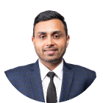


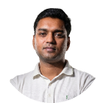

5
GLOBAL PRODUCT EXPERTS
Ankur Rander
Siddhesh Pednekar
Founder & CEO
Partner & COO
Jorge Andres Sierra
Sugesh Sugathan
Product Design Director
Associate Director, Design
Alex Solod
Siddhesh Pednekar
Product Design Director
Partner & COO

Slide 8
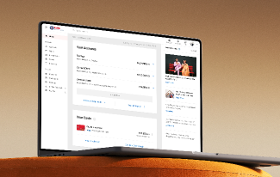
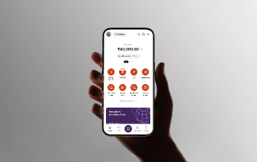
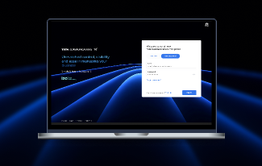
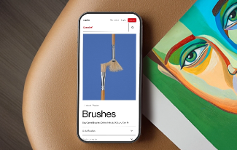
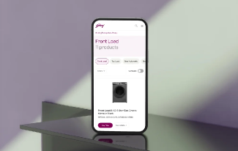
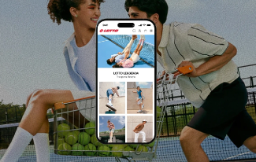
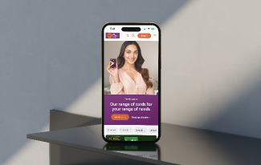
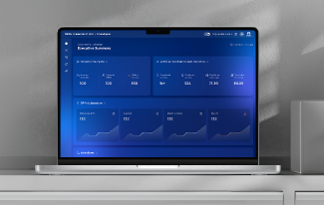
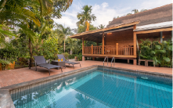
6
SELECTED CASES
Kotak Netbanking
AU Bank (Mobile App)
TCX Platform
Kokuyo Camlin
22% increase in engagement
Reimagining Mobile banking for a universal bank
Simplifying enterprise connectivity at scale.
2,00,000 artists joined the online artists community we envisioned.
You
Events.
Villas.
Villas.
Culinary
Destination / Villas
Check-in
Checkout
Guests
Where are you going?
Add dates
Add dates
Add guests
Godrej Enterprises
CHOOSE A COLLECTION
StayVista
AU Bank (Website)
Threadspan
₹189 B worth of business represented through the website.
97% increase in conversion rate from checkout to payment.
80% increase in leads
Top 10
A real-time network monitoring platform.
Top 10
Top 10
Top 10
Impeccable
View Villas
Culinary Experience
Villas
Top 10
Event-Friendly
Villas
Luxury Villas
Luxury Villas
Top 10
Top 10
Top 10
Top 10
Top 10
Top 10
Top 10
Top 10
Top 10
Top 10
Pet-Friendly
Villas
Top 10
Top 10
Pool
Villas
Beach
Villas
Kids Friendly
Villas
Celebrity
Choice
Villas
Farm Stay
Villas
Corporate
Offsite
Villas
Wedding
Villas
OFFERS FOR YOU
Stay for 2 Pay for 1
First night at ₹4,999!
All meals on us!
Weekdays at 30% off!
Expires December 31, 2022
Expires December 31, 2022
You can add an offer during checkout
Expires December 31, 2022
Expires December 31, 2022
Featured
villa rentals
1
IN
50
Homes
accepted
500+
Handpicked
homes
250,000+
Happy guests
hosted

Slide 9
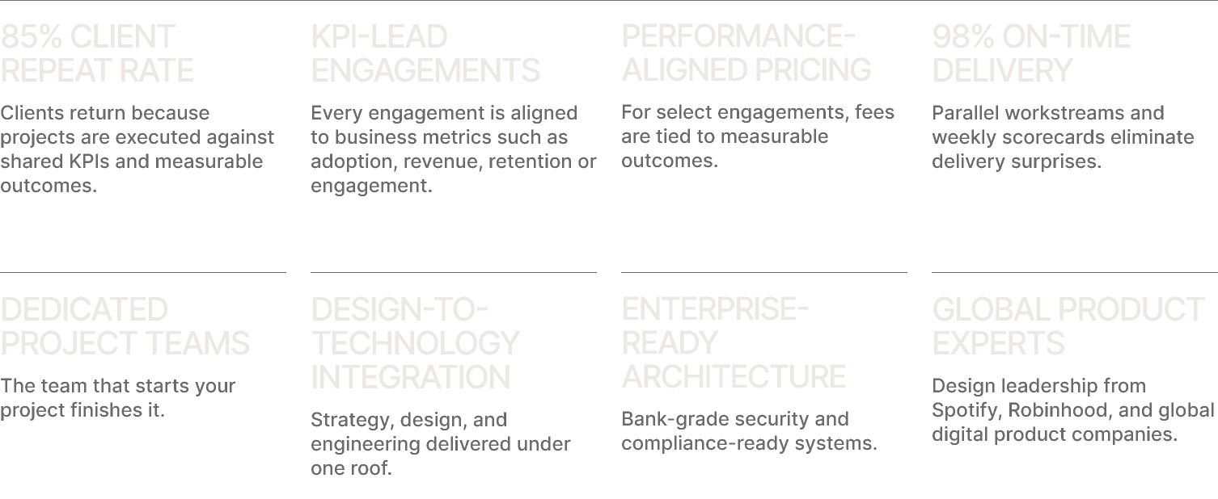
7
WHY CLIENTS TRUST US

Slide 10
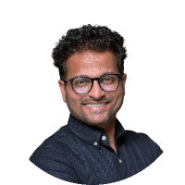
LET'S BUILD
WHAT'S NEXT
Explore our work, sectors, and point of view at www.bombaydc.com
Siddesh Pednekar
Partner & COO
sid@bombaydc.com
9819981354
CONFIDENTIAL AND PROPRIETARY | © BombayDC.
This material is intended solely for your internal use and any use of this material without specific permission of BombayDC is strictly prohibited. All rights reserved.

